Slide 1

Data Structures
Module Number: 1.2
Module Name: Arrays
Version: DSA3
Released Date : 2-AUG-2018

Slide 2
Arrays
AIM
To learn how to store the data in linear structure

Slide 3
Arrays
Objective of This Module
We learn how to store data in linear structures
We learn how to Create these linear structures called Arrays
Initialize the elements in the structure
Manipulate the elements in the array
Read into and write from the structure

Slide 4
Arrays
Expected Outcome of this Module
Understand advanced use of arrays
To know creation and storage of array
Accessing array elements
Performing different operations on array

Slide 5
Arrays
Arrays
There are computing problems which require us to store and work on collection of
Data.
Example:
Let us suppose we want to create a Phone book which records the name and phone no
of persons.
Solution:
Array of structure
.

Slide 6
Arrays
Definition - Arrays
A linear data structure is that whose elements form a sequence.
Simplest data structures and very ease to traverse, sort, search etc.
Definition – An array stores a list of finite number of homogeneous data elements.
The number n is called length or size or range of an array.

Slide 7
Arrays
Arrays
Array: a set of pairs (index and value)
data structure
For each index, there is a value associated with
that index.
representation (possible)
implemented by using consecutive memory.

Slide 8
Arrays
Introducing Arrays
Array is a data structure that represents a collection of the same types of data.
Figure 1.2.1: An Array of 10 Elements of type double

Slide 9
Arrays
Declaring Array Variables
datatype[] arrayname;
Example:
double[] myList;
datatype arrayname[];
Example:
double myList[];

Slide 10
Arrays
Creating Arrays
arrayName = new datatype[arraySize];
Example:
myList = new double[10];
myList[0] references the first element in the array.
myList[9] references the last element in the array.

Slide 11
Arrays
Declaring and Creating in One Step
datatype[] arrayname = new
datatype[arraySize];
double[] myList = new double[10];
datatype arrayname[] = new datatype[arraySize];
double myList[] = new double[10];

Slide 12
Arrays
The Length of Arrays
Once an array is created, its size is fixed. It cannot be changed. You can find its size using:
arrayVariable.length
For example,
myList.length returns 10

Slide 13
Arrays
Initializing Arrays
Using a loop:
for (int i = 0; i < myList.length; i++)
myList[i] = i;
Declaring, creating, initializing in one step:
double[] myList = {1.9, 2.9, 3.4, 3.5};
This shorthand syntax must be in one statement.

Slide 14
Arrays
One-dimensional arrays
The simplest form of an arrays is one-dimensional array.
The array itself is given a name and its elements are referred to by their subscripts.
The notation of an array can be given as follows:
Array name[lower bound L, Upper bound u]

Slide 15
Arrays
Memory Allocation
In memory, one-dimensional arrays are implemented by allocating a sequence of addressed locations so as to accommodate all its elements.
The starting address of the very first element of the array is called base address of the array.
The elements of arrays are given contiguous memory locations.
To find the address
Address of element with subscript I= Base address + ES(I-L)
ES- Size of an array element
I- Subscript of the array
L- Lower bound of the array

Slide 16
Arrays
Operations of One-dimensional arrays
Searching
-> Linear Search
-> Binary Search
Insertion
Deletion
Sorting
-> Selection Sort
-> Bubble sort
-> Insertion
Merging

Slide 17
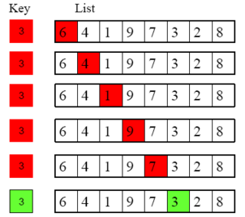
Arrays
Example: Linear Search
Figure 1.2.2: Linear search
Notes:
Linear Search
Step1: Create the array
Step2: Enter the elements in the array
Step3: Ask from user element to be searched
Step4: Repeat step 5 until element to be searched is found or array is exhausted
Step5: Match the element to be searched one by one with elements in array

Slide 18
Arrays
Example: Binary Search
A binary search works on an ordered list, and first compares the key with the element in the middle of the array. (In the case of an even number of elements in our list, we will use the element that ends the first half of the list as our "middle element").
If the key is less than the middle element, we only need to search the first half of the array, so we continue searching on this smaller list.
If the key is greater than the middle element, we only need to search the second half of the array, so we continue searching on this smaller list.
If the key equals the middle element, we have a match -- end the search

Slide 19
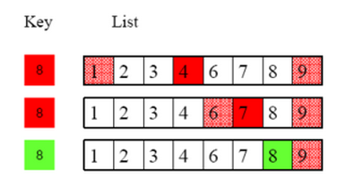
Arrays
Example: Binary Search
Figure 1.2.3: Binary search
Notes:
Note how we keep track of the sublist we are actually searching by keeping track of its left-most and right-most elements.
Initially, we are searching the entire list, so the left-most element is 1, while the right-most element is 9. There is an even number of elements in our list, so as mentioned above, we use the element that ends the first half of the list as our "middle element" (i.e., the "4").
Since 4 is less than the key value 8, we only need to search the second half of the list from 1 to 9. As such, we update the left-most element of the list searched to be the "6", while we leave the right-most element of the list searched unchanged (it's still the 9).
The "middle element" of this sublist, which again has an even number of elements, is again taken as the element that ends the first half of this sublist from 6 to 9, which is 7.
Since 7 is still less than the key value 8, we again only need to search the second half of the sublist from 6 to 9. As such, we update the left-most element of the sublist searched to be the 8, while we leave the right-most element of the sublist searched unchanged (it's still the 9).
The "middle element" of this sublist, which again has an even number of elements, is again taken to be the element that ends the first half of this sublist from 8 to 9, which is 8. (Note, as the sublist only has two elements, following the aforementioned rule for finding "middles", gives us a middle for this sublist identical to the "left-most" element of this sublist.)
Since 8 equals the key value, we stop the search, we have found what we were looking for!
Of course, we need to be keeping track of the indices of each of the elements, so we know what position to return, when we are all done.

Slide 20
Arrays
Figure 1.2.4: Example: Insertion in Array
Step1: Array in which element to be inserted
Index
0
1
2
3
4
5
6
7
8
10
15
1
36
27
5
23
Step2: Check whether array is Full or not if Full then output Overflow error else go to step 3
Index
0
1
2
3
4
5
6
7
8
10
15
1
36
27
5
23
Step3: Input, Element to be inserted and Position at which to be inserted
Value to be Inserted : 35
Index at which to be inserted: 5
Step4: Shift element to right to make position empty, where element is to be inserted
Index
0
1
2
3
4
5
6
7
8
10
15
1
36
27
5
23
Step5: Insert element
Index
0
1
2
3
4
5
6
7
8
15
36
27
35
5
23
10
15
1
27

Slide 21
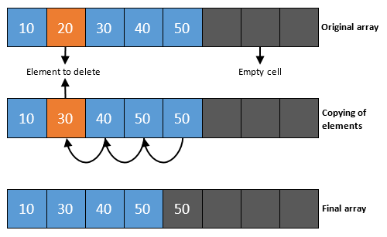
Arrays
Example: Deletion in Array
Figure 1.2.5: Deletion of element in an Array
Notes:
Step by step descriptive logic to remove element from array.
Move to the specified location which you want to remove in given array.
Copy the next element to the current element of array. Which is you need to perform array[i] = array[i + 1].
Repeat above steps till last element of array.
Finally decrement the size of array by one.

Slide 22
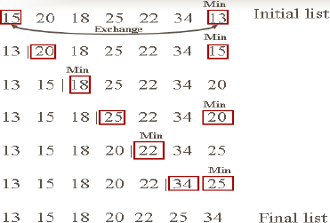
Arrays
Example: Sorting
SELECTION SORT
Figure 1.2.6: Selection sort example
Notes:
There are many different ways to sort the cards. Here's a simple one, called selection sort, possibly similar to how you sorted the cards above:
Find the smallest card. Swap it with the first card.
Find the second-smallest card. Swap it with the second card.
Find the third-smallest card. Swap it with the third card.
Repeat finding the next-smallest card, and swapping it into the correct position until the array is sorted.

Slide 23
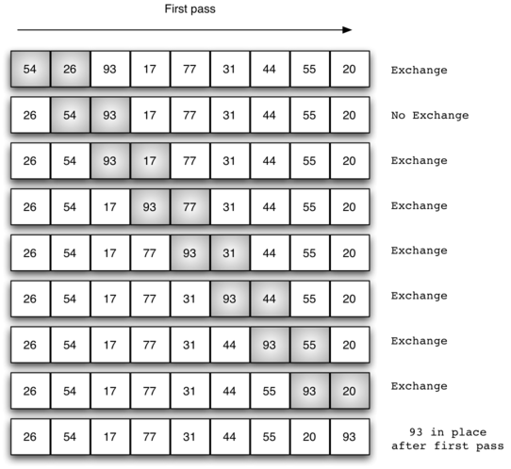
Arrays
Example: Sorting
BUBBLE SORT
Figure 1.2.7: Bubble Sort
Notes:
begin
BubbleSort(list)
for all elements of list
if list[i] > list[i+1]
swap(list[i], list[i+1])
end if
end for
return list end BubbleSort

Slide 24
Arrays
Applications of Array
To implement mathematical vectors and matrices.
Used to implement other data structures.
Used to emulate in-memory dynamic memory allocation.
Used to determine the partial or complete control-flow in programs.

Slide 25
Arrays
Applications of Array
Array Can be Used in CPU Scheduling
Arrays can be used in various CPU scheduling algorithms. CPU Scheduling is generally managed by
Queue.
Queue can be managed and implemented using the array. Array may be allocated dynamically i.e at run
time.

Slide 26

Arrays
Array as an ADT
The array is a basic abstract data type that holds an ordered collection of items accessible by an integer index.
Since it's an ADT, it doesn't specify an implementation, but is almost always implemented by an array (data structure) or dynamic array.
Figure 1.2.8: One Dimensional Array

Slide 27
Arrays
Array as an ADT
An array is an Abstract Data Type
The array type has a set of values
The values are all the possible arrays
The array type has a set of operations that can be applied uniformly to each of these values
The only operation is indexing
Alternatively, this can be viewed as two operations:
- inspecting an indexed location
- storing into an indexed location
It’s abstract because the implementation is hidden: all access is via the defined operations

Slide 28
Arrays
Subarray as an ADT
To use a subarray, you must keep track of (1) the array itself, (2) the lower bound, and (3) the upper bound
class Subarray<V> { V[ ] subarray; int lowerBound; int upperBound; // Constructor, some methods... }
Advantage: Only one object to pass around
Disadvantages: The subarray must hold Objects not primitives

Slide 29
Arrays
Some languages (Fortran, Pascal) support two-dimensional (2D) arrays:
columns
a
b
c
d
A two-dimensional array may be stored in one-dimensional computer memory in either of two ways:
rows
e
f
g
h
i
j
k
l
logical view
row 0
row 1
row 2
row major order:
a
b
c
d
e
f
g
h
i
j
k
l
col 0
col 1
col 2
col 3
column major order:
a
e
i
b
f
j
c
g
k
d
h
l
29
Figure 1.2.9: Row major and column major view

Slide 30
Arrays
Two-dimensional arrays II
In a 2D array, we generally consider the first index to be the row, and the second to be the column: a[row, col]
columns 0 1 2 3 4
0
1
2
3
0,0
0,1
0,2
0,3
0,4
rows
1,0
1,1
1,2
1,3
1,4
2,0
2,1
2,2
2,3
2,4
3,0
3,1
3,2
3,3
3,4
Figure 1.2.10: 2D Array

Slide 31
Arrays
2D arrays
Java doesn’t have “real” 2D arrays, but array elements can themselves be arrays:
int x[][] denotes an array x of array components, each of which is an array of integer components
We can define the above array like this: x = new int[5][8]; and treat it as a regular 2D array
This is an array of 5 arrays
Each subarray is an array of 8 ints
Figure 1.2.11: Array of Arrays (2D Array)

Slide 32
Objects: A set of pairs <index, value> where for each value of index there is a value from the set item. Index is a finite ordered set of one or more dimensions, for example, {0, … , n-1} for one dimension, {(0,0),(0,1),(0,2),(1,0),(1,1),(1,2),(2,0),(2,1),(2,2)} for two dimensions, Methods: for all A ∈ Array, i ∈ index, x ∈ item, j, size ∈ integer Array Create(j, list) ::= return an array of j dimensions where list is a j-tuple whose kth element is the size of the kth dimension. Items are undefined. Item Retrieve(A, i) ::= if (i ∈ index) return the item associated with index value i in array A else return error Array Store(A, i, x) ::= if (i in index) return an array that is identical to array A except the new pair <i, x> has been inserted else return error
Arrays
The Array ADT

Slide 33
Arrays
Other Data Structures Based on Arrays
Arrays:
Basic data structure
May store any type of elements
Polynomials: defined by a list of coefficients and exponents
- degree of polynomial = the largest exponent in a polynomial
Polynomials A(X)=3X²⁰+2X⁵+4, B(X)=X⁴+10X³+3X²+1

Slide 34
Arrays
Polynomial ADT
Objects: a set of ordered pairs of <e_{i},a_{i}> where a_{i} in Coefficients and e_{i} in Exponents, e_{i} are integers >= 0 Methods: for all poly, poly1, poly2  Polynomial, coef Coefficients, expon  Exponents Polynomial Zero( ) ::= return the polynomial p(0) Boolean IsZero(poly) ::= if (poly) return FALSE else return TRUE Coefficient Coef(poly, expon) ::= if (expon  poly) return its coefficient else return Zero Exponent Lead_Exp(poly) ::= return the largest exponent in poly Polynomial Attach(poly,coef, expon) ::= if (expon  poly) return error else return the polynomial poly with the term <coef, expon> inserted

Slide 35
Arrays
Polynomial Addition
Use an array to keep track of the coefficients for all exponents
A(X)=2X¹⁰⁰⁰+1
B(X)=X⁴+10X³+3X²+1
Running time?
A
B
advantage: easy implementation
disadvantage: waste space when sparse
Figure 1.2.12: Array representation of Polynomial keeping exp as index

Slide 36
Arrays
Store pairs of exponent and coefficient
A(X)=2X¹⁰⁰⁰+1
B(X)=X⁴+10X³+3X²+1
advantage: less space
disadvantage: longer code
starta finisha startb finishb avail
coef
exp
0 1 2 3 4 5 6
Figure 1.2.13: 2D Array representation of Polynomial

Slide 37
Arrays
Sparse Matrices
A matrix is a two-dimensional data object made of m rows and n columns, therefore having total m x n values. If most of the elements of the matrix have 0 value, then it is called a sparse matrix.
Reasons for using Sparse matrix:
Storage: There are lesser non-zero elements than zeros and thus lesser memory can be used to store only those elements.
Computing time: Computing time can be saved by logically designing a data structure traversing only non-zero elements.

Slide 38
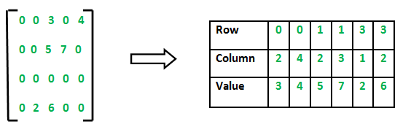
Arrays
Row and column Major Representation
2D array is used to represent a sparse matrix in which there are three rows named as
Row: Index of row, where non-zero element is located
Column: Index of column, where non-zero element is located
Value: Value of the non zero element located at index – (row, column)
Figure 1.2.14: Array representation of Sparse Matrix

Slide 39
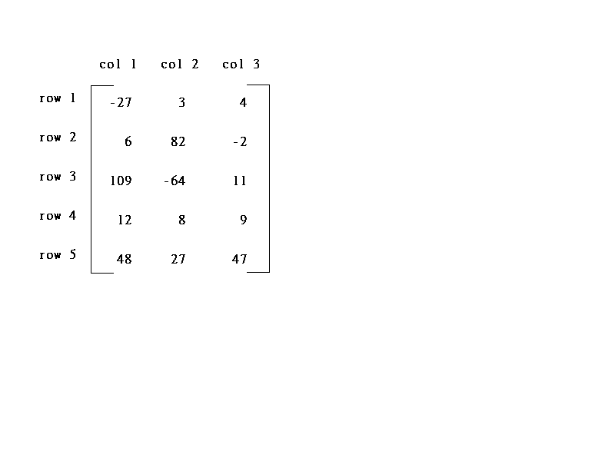
Arrays
Sparse Matrices
col0 col1 col2 col3 col4 col5
row0
row1
row2
row3
row4
row5
5*3
6*6
15/15
8/36
sparse matrix
data structure?
Figure 1.2.15: Example of sparse matrix

Slide 40
Arrays
Sparse Matrix ADT
Objects: a set of triples, <row, column, value>, where row and column are integers and form a unique combination, and value comes from the set item. Methods:
for all a, b  Sparse_Matrix, x  item, i, j, max_col, max_row  index Sparse_Marix Create(max_row, max_col) ::= return a Sparse_matrix that can hold up to max_items = max _row  max_col and whose maximum row size is max_row and whose maximum column size is max_col.

Slide 41
Arrays
Sparse_Matrix Transpose(a) ::= return the matrix produced by interchanging the row and column value of every triple. Sparse_Matrix Add(a, b) ::= if the dimensions of a and b are the same return the matrix produced by adding corresponding items, namely those with identical row and column values. else return error

Slide 42
Arrays
Sparse_Matrix Multiply(a, b) ::= if number of columns in a equals number of rows in b return the matrix d produced by multiplying a by b according to the formula: d [i] [j] = (a[i][k]•b[k][j]) where d (i, j) is the (i,j)th element else return error.

Slide 43
Arrays
Sparse Matrix Representation
(1) Represented by a two-dimensional array.
Sparse matrix wastes space.
(2) Each element is characterized by <row, col, value>.

Slide 44
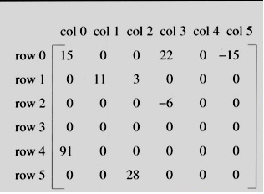
Introduction to Data structures
The sparse matrix ADT
Representation of unstructured sparse matrix as single linear list in row-major order.
Figure 1.2.16 shows how the sparse matrix is represented in the array A[].
Represented by a two-dimensional array.
Each element is characterized by <row, col, value>.
Index | row | col | value
A[0] | 0 | 0 | 15
[1] | 0 | 3 | 22
[2] | 0 | 5 | -15
[3] | 1 | 1 | 11
[4] | 1 | 2 | 3
[5] | 2 | 3 | -6
[6] | 4 | 0 | 91
[7] | 5 | 2 | 28
Figure 1.2.16: Sparse Matrix representation as an Array

Slide 45
Arrays
Transpose a Sparse Matrix
Write Pseudo codes for transposing sparse matrix.
Analyze its complexity.
Example:
(0, 0, 15) ====> (0, 0, 15)
(0, 3, 22) ====> (3, 0, 22)
(0, 5, -15) ====> (5, 0, -15)
(1, 1, 11) ====> (1, 1, 11)
Note: your array is one dimensional

Slide 46
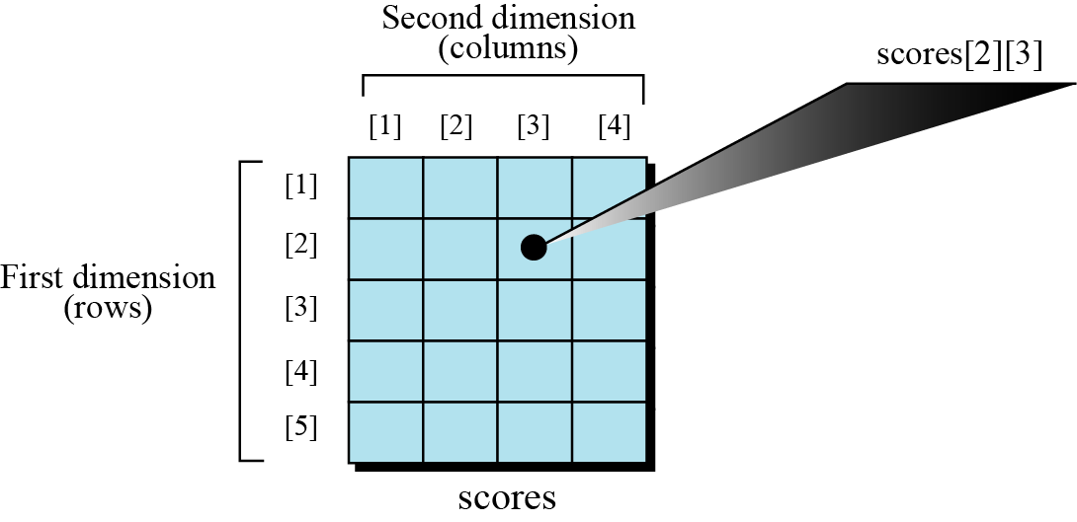
Arrays
Multi-dimensional arrays
Many applications require that data be stored in more than one dimension. Figure shows a table, which is commonly called a two-dimensional array.
Figure 1.2.17: 2 D Array

Slide 47
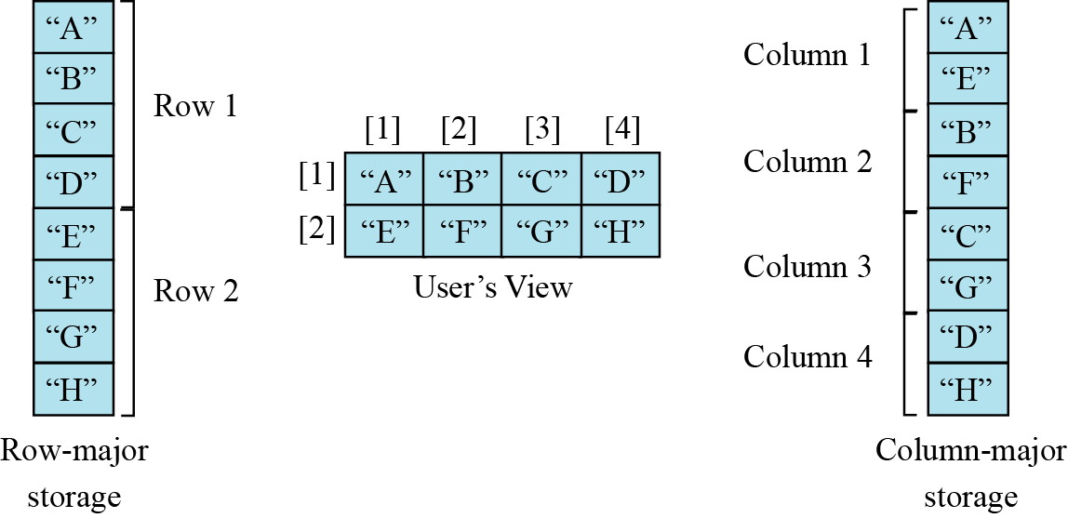
Arrays
Memory layout
The indexes in a one-dimensional array directly define the relative positions of the element in actual memory. Figure 11.6 shows a two-dimensional array and how it is stored in memory using row-major or column-major storage. Row-major storage is more common.
Figure 1.2.18: Memory Layout of Arrays

Slide 48
Arrays
We have stored the two-dimensional array students in memory. The array is 100 × 4 (100 rows and 4 columns). Show the address of the element students[5][3] assuming that the element student[1][1] is stored in the memory location with address 1000 and each element occupies only one memory location. The computer uses row-major storage.
Solution
We can use the following formula to find the location of an element, assuming each element occupies one memory location.
If the first element occupies the location 1000, the target element occupies the location 1018.

Slide 49
Arrays
Operations on array
We can apply conventional operations defined for each element of an array, there are some operations that we can define on an array as a data structure.
The common operations on arrays as structures are searching, insertion, deletion, and retrieval.

Slide 50
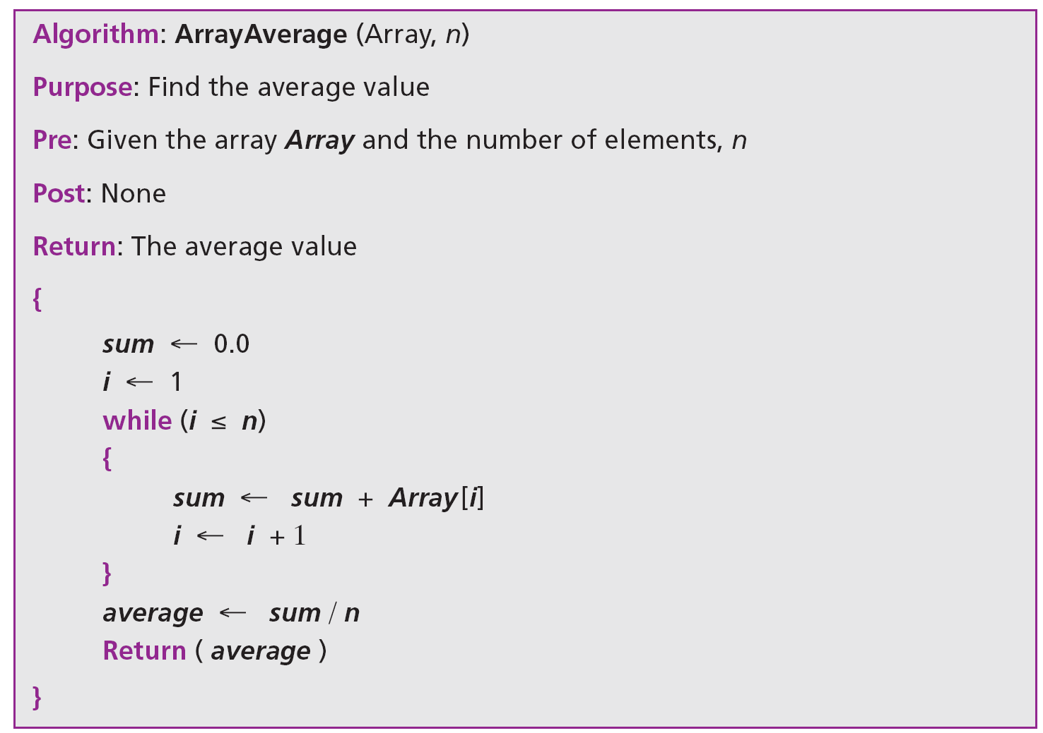
Arrays
Algorithm stated below is an example of finding the average of elements in array whose elements are reals.

Slide 51
Arrays
Application
If we have a list in which a lot of insertions and deletions are expected after the original list has been created, we should not use an array. An array is more suitable when the number of deletions and insertions is small, but a lot of searching and retrieval activities are expected.

Slide 52
Arrays
RECORDS
A record is a collection of related elements, possibly of different types, having a single name.
Each element in a record is called a field.
A field is the smallest element of named data that has meaning.
A field has a type and exists in memory.
Fields can be assigned values, which in turn can be accessed for selection or manipulation.
A field differs from a variable primarily in that it is part of a record.

Slide 53
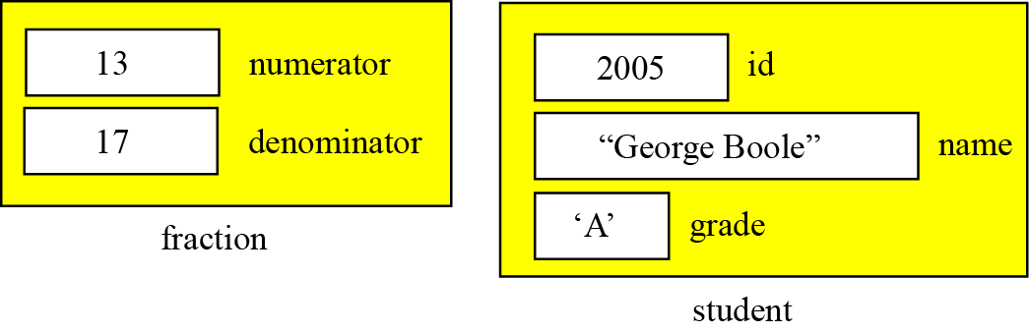
Arrays
Figure contains two examples of records. The first example, fraction, has two fields, both of which are integers. The second example, student, has three fields made up of three different types.
Figure 1.2.19: Example of Records

Slide 54
Arrays
Comparison of records and arrays
An array defines a combination of elements, while a record defines the identifiable parts of an element.
For example, an array can define a class of students (40 students), but a record defines different attributes of a student, such as id, name or grade.

Slide 55
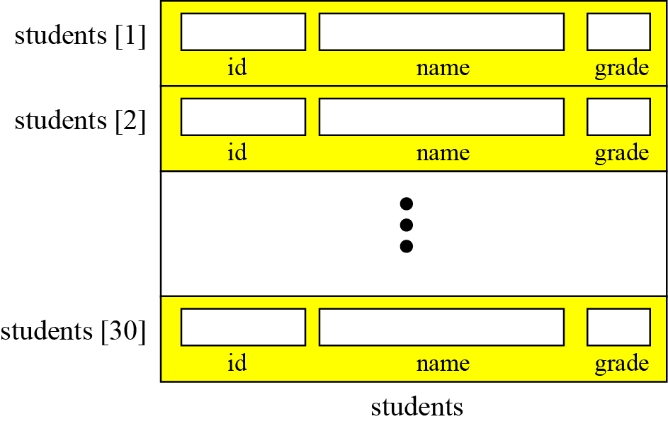
Arrays
Array of records
If we need to define a combination of elements and at the same time some attributes of each element, we can use an array of records. For example, in a class of 30 students, we can have an array of 30 records, each record representing a student.
Figure 1.2.20: Array of Records

Slide 56
Arrays
The following shows how we access the fields of each record in the students array to store values in them.

Slide 57
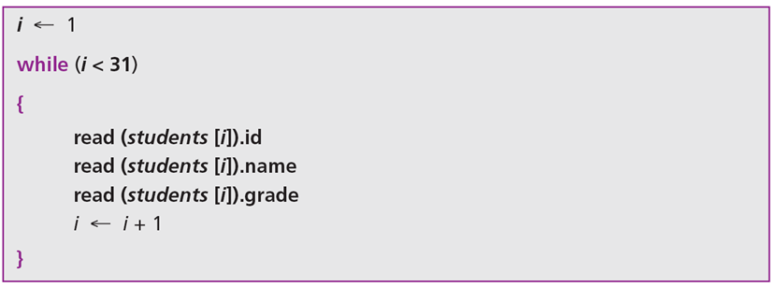
Arrays
However, we normally use a loop to read data into an array of records. Algorithm given below shows part of the pseudocode for this process.
Algorithm: Part of Pseudocode

Slide 58
Arrays
Arrays versus arrays of records
Both an array and an array of records represent a list of items. An array can be thought of as a special case of an array of records in which each element is a record with only a single field.

Slide 59
Arrays
Pointer Arrays
An array of pointers can be used to point to an array of data items with each element of the pointer array pointing to an element of the data array.
Data items can be accessed either directly in the data array, or indirectly by dereferencing the elements of the pointer array.

Slide 60
Arrays
Self Assessment Questions
Which is the simplest form of an array?
Single dimension
Two dimension
Multi-dimension
All of the Above
Answer: a)
Notes:
a)

Slide 61
Arrays
2. The starting address of the very first element of the array is called ……… of the array.
Base address
First Address
Index of the array
None of the Above
Answer: a)
Notes:
2. a)

Slide 62
Arrays
An array elements are always stored in …………………memory locations
Sequential
Random
Sequential & Random
None of the Above
Answer: a)
Notes:
3. a)

Slide 63
Arrays
Assignment
Q1. What are the main advantages and disadvantages of using arrays?
Q2. Write a program in C for multiplication of two square matrix.
Q3. State and explain algorithm for binary search.
Q4. Explain bubble sort algorithm with the help of suitable example.
Q5. What is sparse matrix? Explain in detail one way of representing sparse matrix using array.
Q6. What is the difference between array and structures?
Q7. Write a program in C to implement structure and access the values stored.

Slide 64
Arrays
Document Links
TOPICS | URL | Notes
Memory allocation of Array | https://pdos.csail.mit.edu/6.828/2012/readings/pointers.pdf | This link explain the Memory allocation of array
Types of array | http://www.griet.ac.in/nodes/UNIT-III(QA)_cp.pdf | This explain about the different types of arrays
Applications of Array | http://ee.hawaii.edu/~tep/EE160/Book/PDF/Chapter9.pdf | It explains the different applications of array

Slide 65
Arrays
Video Links
TOPICS | URL | Notes
Memory allocation of Array | https://www.youtube.com/watch?v=ljbAysOT4WQ | This link explain the Memory allocation of array
One-dimensional array | https://www.youtube.com/watch?v=vEsyuBZdrC8 | This link explains the one-dimensional array
Pointer arrays | https://www.youtube.com/watch?v=mKrwrQMT0a4 | This links explains the concept of pointer arrays

